Slide 1

Audi Case Study
Harsh Patel, Kalp Patel, Deepishka Pemmasani, Tejaswi Mallidi, Poorva Reddy Vanga, Pallavi Vandanapu, Bhavana Bethi

Slide 2

Introduction
Topic: AUDI AG's attempts to implement big data analytics
Truth in Engineering
Headquartered in Germany, originally established in 1909.
Major source of data: Customers through website, car configurator and dealers.
Big data – Car data produces high volume, high velocity of data in variety of formats, low veracity of data on social media.
ThePhoto by PhotoAuthor is licensed under CCYYSA.

Slide 3

Audi's Data Analytics Journey: Transition from Stage 2 to Stage 3
Early Data-Oriented Mindset
Emerging Data Sharing Practices
Application of Data in Targeted Marketing
Introduction of Analytics Tools
Cross-Functional Collaboration

Slide 4
Enterprise: Transition from stage 2 to stage 3
Stage 2
Analytics GmbH: Centralized big data efforts for sales and marketing, but analytics is still confined to these functions rather than integrated company-wide.
IT Collaboration: Data platforms like Tableau and SPSS Modeler are in use, but enterprise-wide data standards and a unified data warehouse are still in progress.
Limited Analytics Reach: Current focus is on sales and marketing; plans to expand analytics into production, supply chain, and other areas are underway but not yet implemented.
Data Governance: Centralized data governance and standardized protocols are under development, impacting data consistency and security.
Future Goals: Need to establish an enterprise-wide data warehouse, enhance cross-departmental data sharing, and integrate analytics across all business units.
Stage 3

Slide 5
Leadership
Stage 2
Stage 3
Nicolas, CMO visualized and created Analytics GmbH for digital services
Identified the need for extrenal agencies for big data analysis
Board members not in complete agreement, looked at minimizing risks and budget
Wanted to implement analytics at sales and marketing and IT dpt

Slide 6
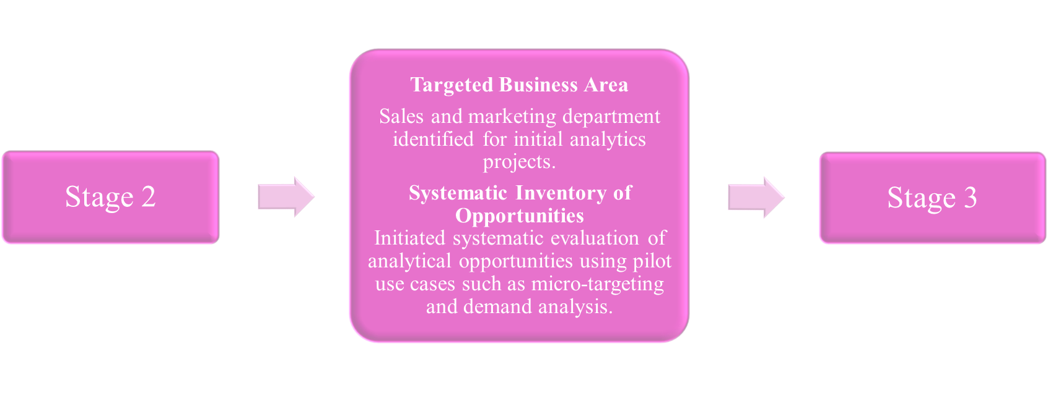
target

Slide 7
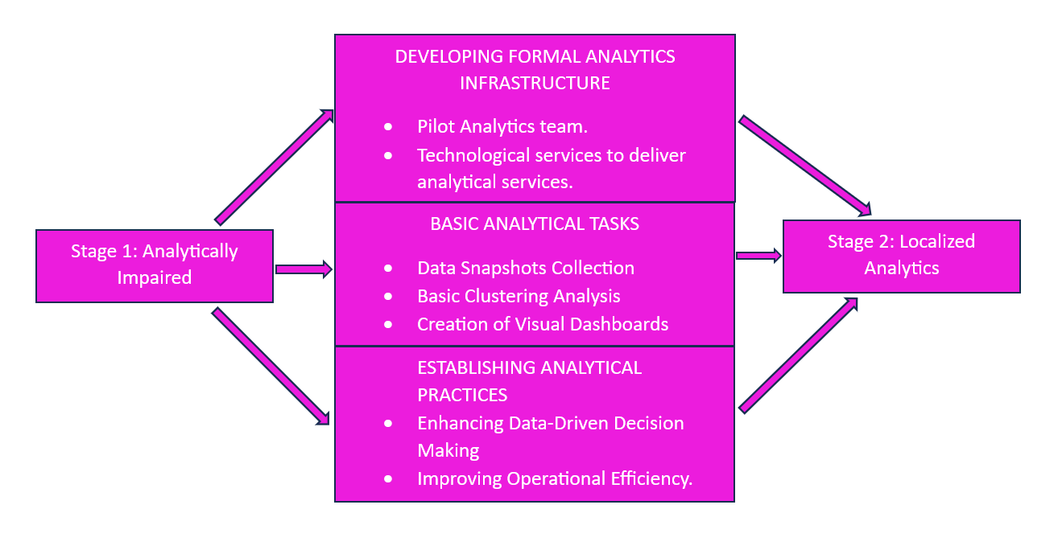
Analysis

Slide 8
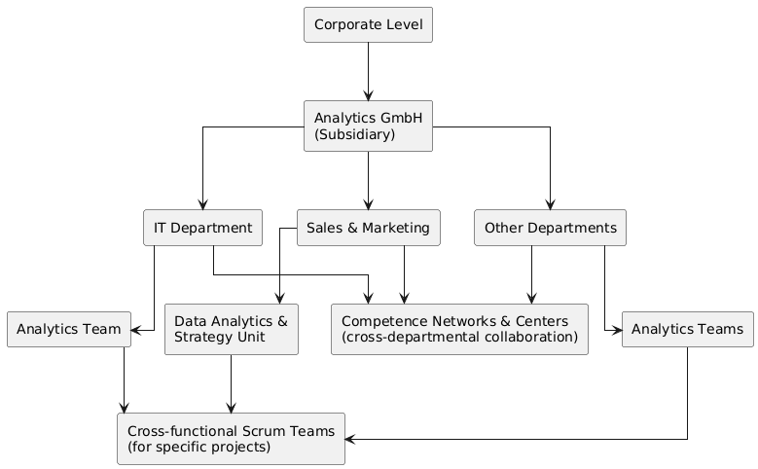
AUDI's analytical team structure
Analytics GmbH, which acts as a centralized analytics capability provider across the organization.
Built analytics capabilities within existing departments.
Used cross-functional teams for analytics projects, combining resources from Analytics GmbH (central) and business units like sales and marketing.

Slide 9
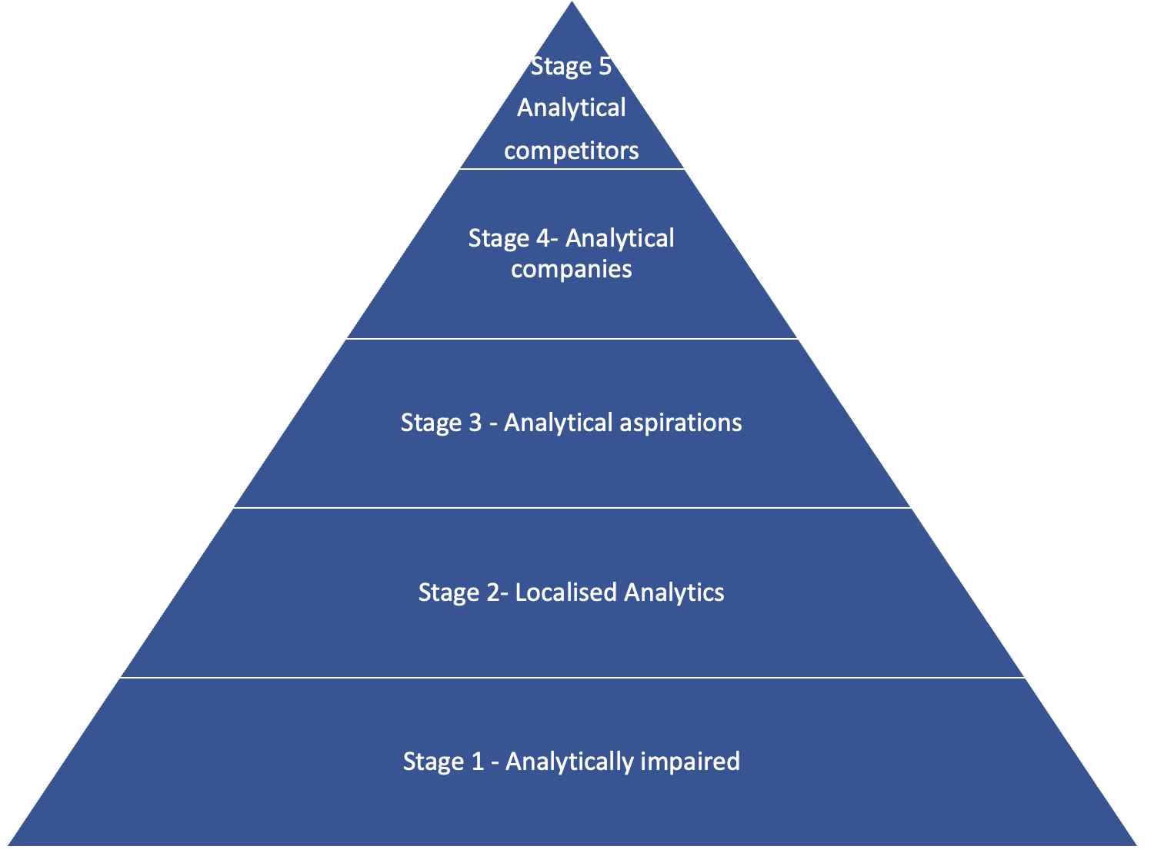
What stage does AUDI belong in the DELTA model?
Stage 3: Analytical Aspirations - Organizations at this level “see the value of analytics.” They are still struggling to mobilize the organization and become more analytical.
Image courtesy: https://zinatullin.com/2023/05/18/how-to-uplift-your-data-analytics-capability/

Slide 10
Thank you!

